Slide 1

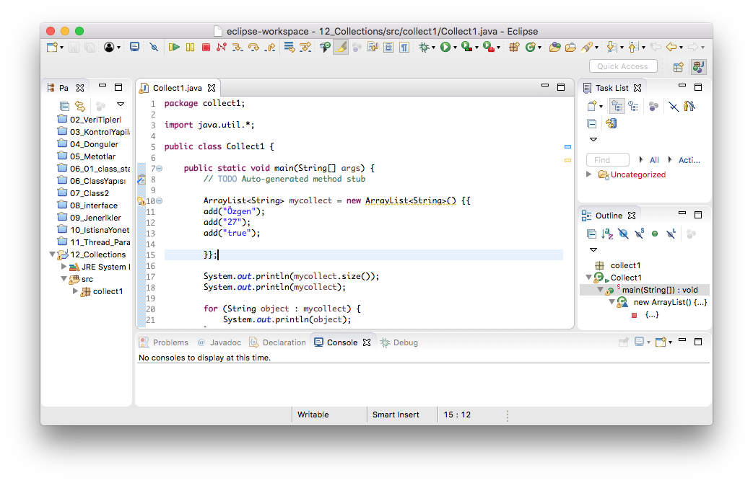
Queue-LinkedList
Queue
Queue methods
Offer
Add -> error
Remove
Poll
Element
Peek
getFirst
getLast
Push

Slide 2
Queue
4
3
2
1

Slide 3
Deque
4
3
2
1

